Slide 1
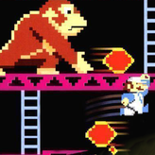
FOR
DONKEY KONG
VIKE
©1981 NINTENDO
2023 BENCE GY. VERESS
APPROVED
PORTED CLASSICS SERIES

